Slide 1
Lecture 10

Slide 2
An Initial Solution

Slide 3
A First Solution
Nouns: Microwave, Powertube, Light, Display, Door, CookButton, etc.
The Display and CookButton will be part of the user interface (GUI).
Powertube and Light: message on the GUI.
Door: GUI component(s).
Microwave:
Timer

Slide 4
Software Classes
Microwave: Keeps track of what state the oven is in,
Turns the power-tube and light on/off.
Listen to:
Opening/closing of the door,
Pushing of the Cook button,
Timer running out
GUI Display:
Components for user input,
Displays: cooking/not cooing
door open/closed
light on/off
time
Clock: Generates a clock tick event at regular intervals.

Slide 5
MicrowaveDisplay

Slide 6
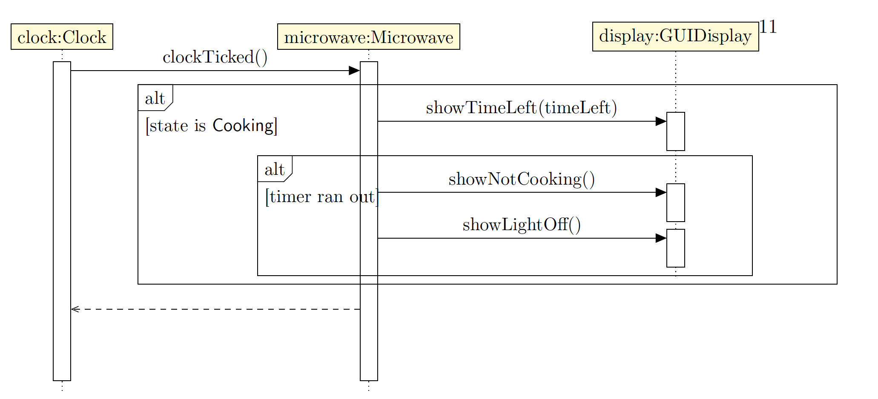
ClockTicked

Slide 7
Open Door

Slide 8
Clock
public class Clock implements Runnable {
private static Microwave microwave;
public Clock() {
microwave = Microwave.instance();
new Thread(this).start();
}
public void run() {
try {
while (true) {
Thread.sleep(1000);
microwave.clockTicked();
}
} catch(InterruptedException ie) {
}
}
}

Slide 9
Display Class
Methods that process the input provided by the user.
Methods that can be invoked by Microwave to display output.

Slide 10
The Display Class
public class GUIDisplay extends Application implements MicrowaveDisplay, EventHandler<ActionEvent> {
private Button doorCloser = new Button("close door"); private Button doorOpener = new Button("open door");
private Button cookButton = new Button("cook");
private Text doorStatus = new Text("Door Closed");
private Text timerValue = new Text(" ");
private Text lightStatus = new Text("Light Off");
private Text cookingStatus = new Text("Not cooking");
// other fields and methods
}

Slide 11
Input Event Processing
public void handle(ActionEvent event) {
if (event.getSource().equals(doorCloser)) {
microwave.doorClosed();
} else if (event.getSource().equals(doorOpener)) {
microwave.doorOpened();
} else if (event.getSource().equals(cookButton)) {
microwave.cookRequested();
}
}

Slide 12
Example of Status Display
public void showLightOn() {
lightStatus.setText("Light On");
}

Slide 13
Microwave Fields
public enum States {DOOR_CLOSED_STATE, DOOR_OPENED_STATE, COOKING_STATE};
private int timeLeft;
private States currentState;
private static Microwave instance;
private MicrowaveDisplay display;

Slide 14
Microwave Constructor
public void setDisplay(MicrowaveDisplay display) {
this.display = display;
currentState = States.DOOR_CLOSED_STATE;
timeLeft = 0;
display.showTimeLeft(timeLeft);
display.showLightOff();
display.showDoorClosed();
display.showNotCooking();
}

Slide 15
Input Events: Clock Tick Event
public void clockTicked() {
if (currentState == States.COOKING_STATE) {
timeRemaining--;
display.showTimeLeft(timeLeft);
if (timeRemaining == 0) {
currentState = States.DOOR_CLOSED_STATE;
display.showNotCooking();
display.showLightOff();
}
}
}

Slide 16
Input Events: Cook Request
public void cookRequested() {
if (currentState == States.DOOR_CLOSED_STATE) {
currentState = States.COOKING_STATE;
display.showCooking();
display.showLightOn();
timeLeft = 60;
display.showTimeLeft(timeLeft);
} else if (currentState == States.COOKING_STATE) {
timeELft += 60;
display.showTimeLeft(timeLeft);
}
}

Slide 17
A Critique
of the
Design

Slide 18
The Microwave Class Has Become Too Large
The methods in our class may not seem too complex, but in a larger system, things could easily get out of hand.
A number of conditionals in our methods. Each method that processes an event has conditionals that switch on the value stored in currentState

Slide 19
Communication Among the Objects
Communication between the display and the microwave
Communication between the clock and the microwave
In both these cases above, the system employs a form of communication where the entire responsibility for the communication rests with the sender, which is not desirable.
In the first case, it appears to be less harmful.
In the second case, moving the responsibility to the listener helps us to define a class that can be used across possibly many applications.

